Slide 1
The Process of Interaction Design
Computer Science Department

Slide 2
Introduction
Phycology
Of what humans can do.
Input
How stimuli are sent from the world and perceived inside the mind
Processing
Cognition, how the brain store and reason with the input
Output
How the brain controls the individual actions out in the world.

Slide 3
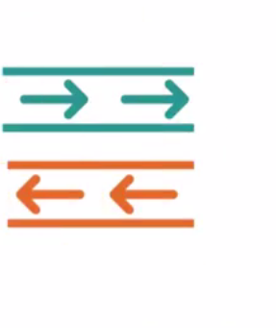

Interaction

Slide 4
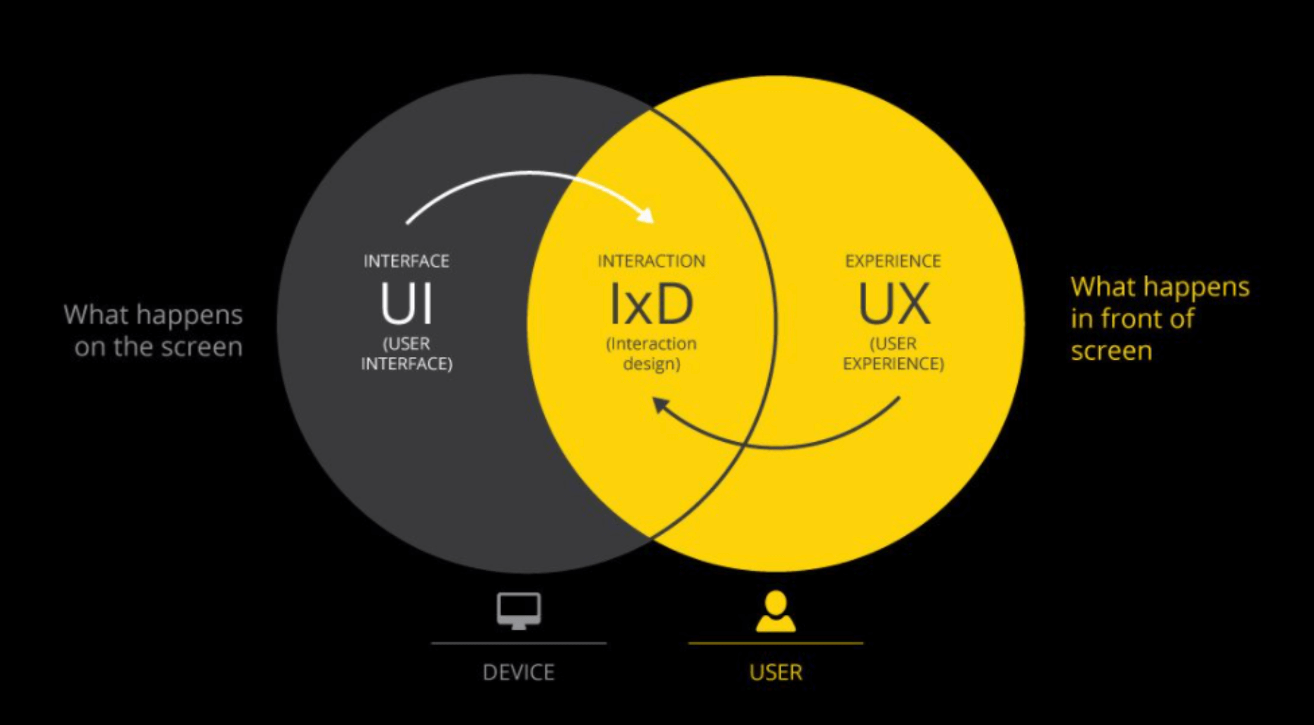
Interaction Design
Designing interactive products to support the way people communicate and interact in their everyday and working life.

Slide 5
Interaction Design Cycle
Discover: Designers try to gather insights about the problem.
Define: Designers develop a clear brief that frames the design challenge.
Develop: Solutions or concepts are created, prototyped, tested, and iterated.
Deliver: The resulting project is finalized, produced, and launched.

Slide 6
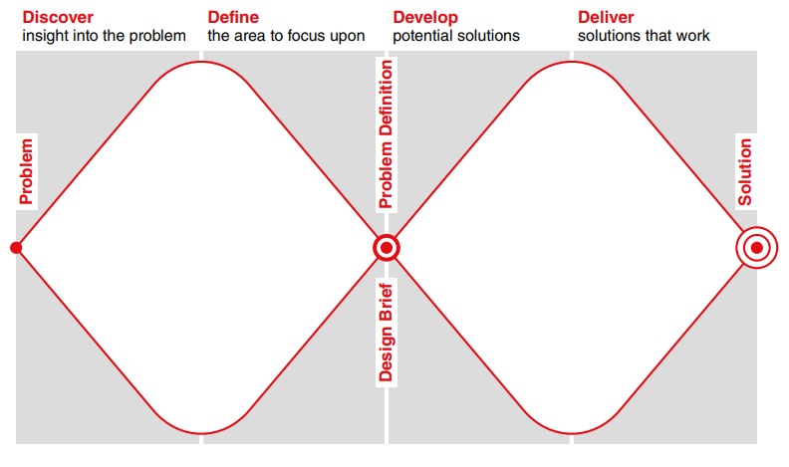
The Double Diamond of Design

Slide 7

Design Trade-off
Deciding how choice should be given to user
and
how much direction system should offer.

Slide 8
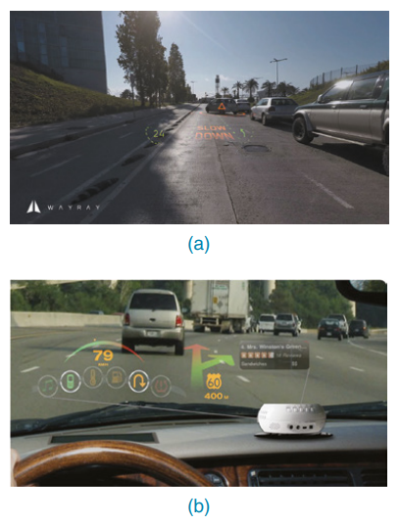
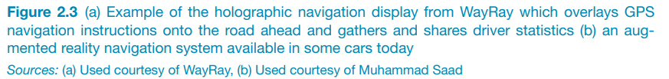
Understanding the Problem Space
What is current user experience of the product?
Why change is needed?
How change will improve the user experience?

Slide 9
Communicating designs
Design and potential solution need to be communicated with people (i.e. actual users) other than the original designers.
Sketches
Descriptions in natural languages
Series of diagrams
Prototyping

Slide 10
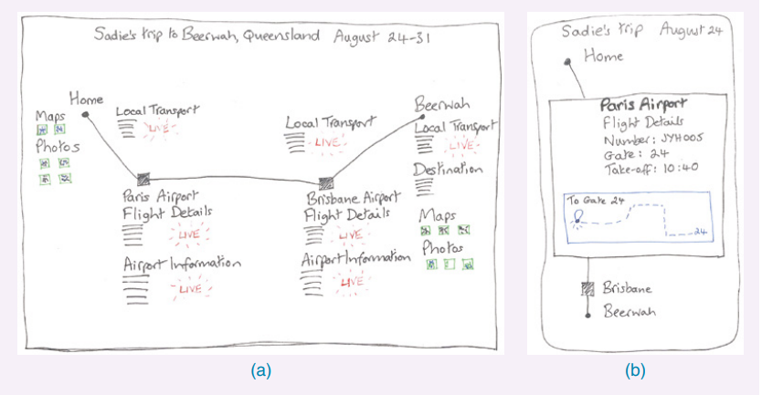
Example

Slide 11
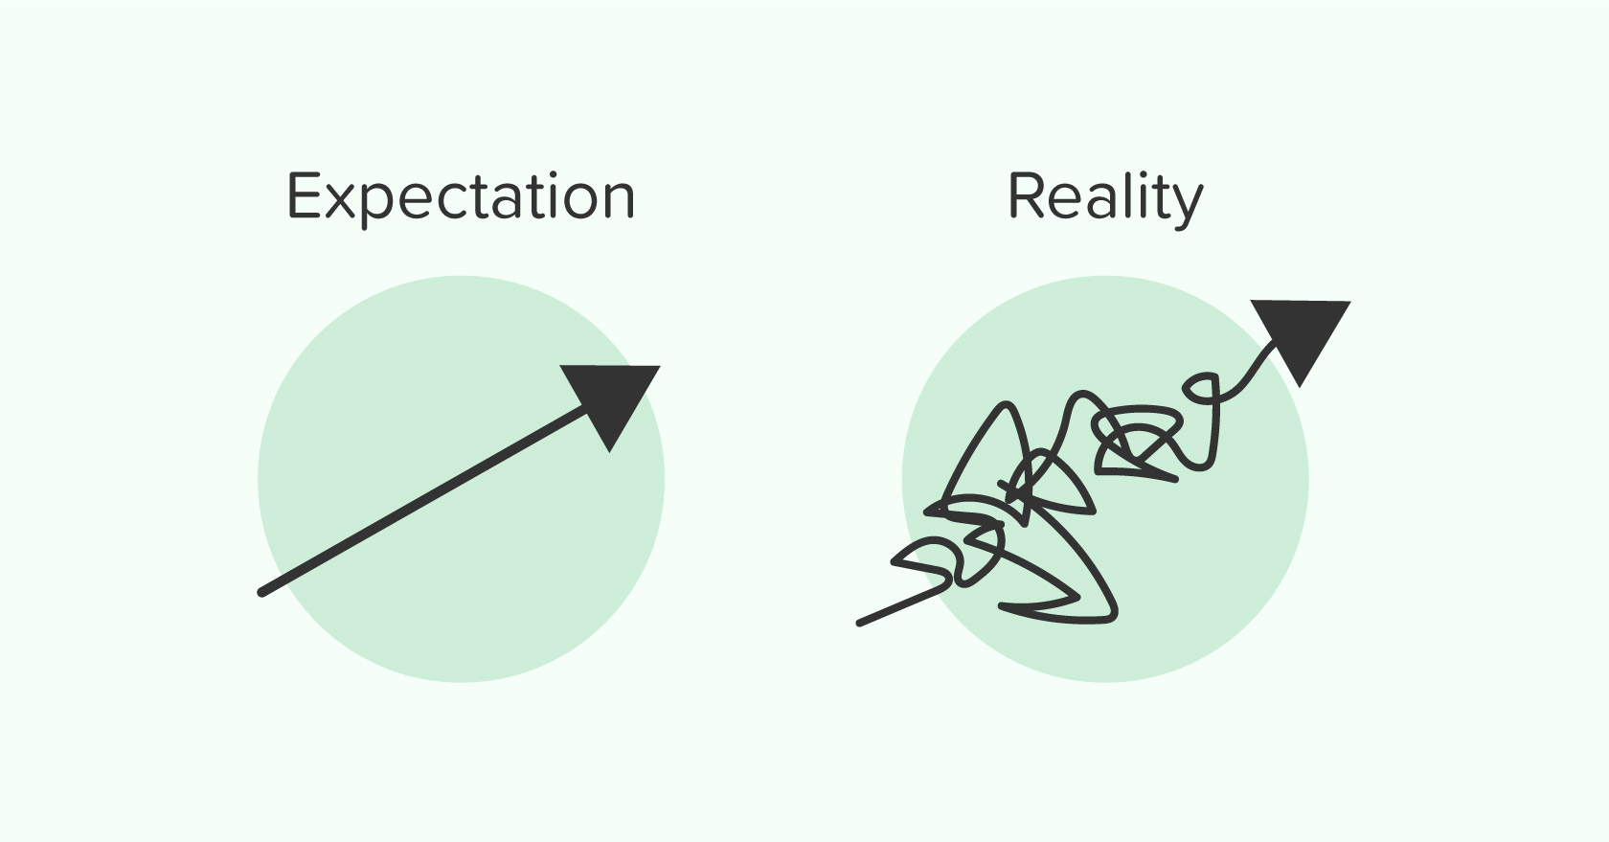
Importance of Involving Users
Product owner (proxy users) is different from actual users.
To make the product usable two things are important from users prospective
Expectation management
Ownership
User involvement require careful consideration and balance to be beneficial.

Slide 12
Degree of User Involvement
Interviews
Focus groups
Online Feedback Exchange
Crowd sourcing
Participatory Design
A/B testing

Slide 13

User Centered Approach
Early focus on users and task
Empirical measurement
Iterative Design
(John Gould and Clayton Lewis , 1985)

Slide 14
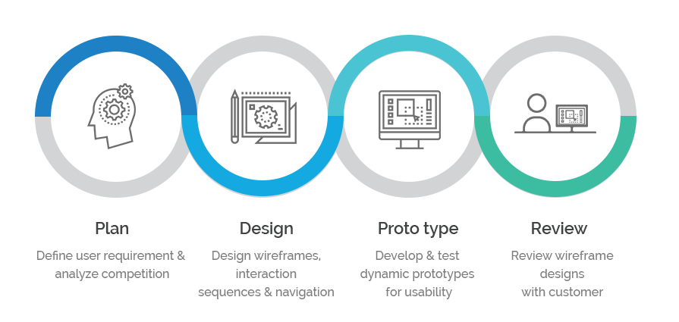
Interaction Design Life Cycle
Discovering Requirement
Designing Alternatives
Prototyping
Evaluating

Slide 15
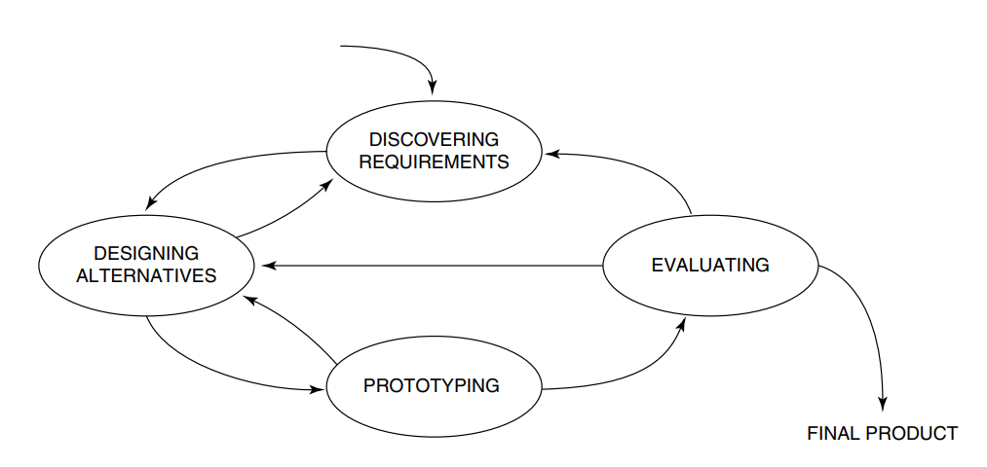
Interaction Design Life Cycle

Slide 16
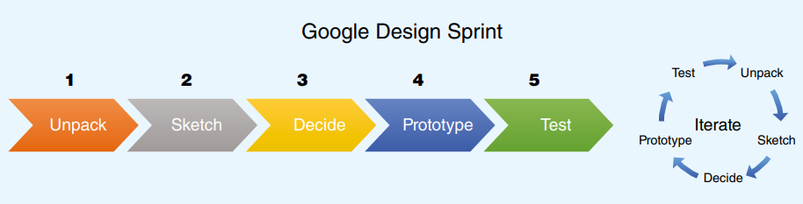
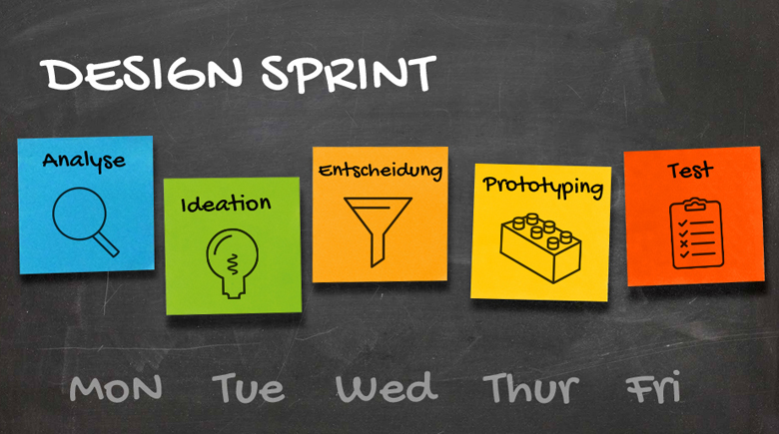
Google Design Sprint

Slide 17
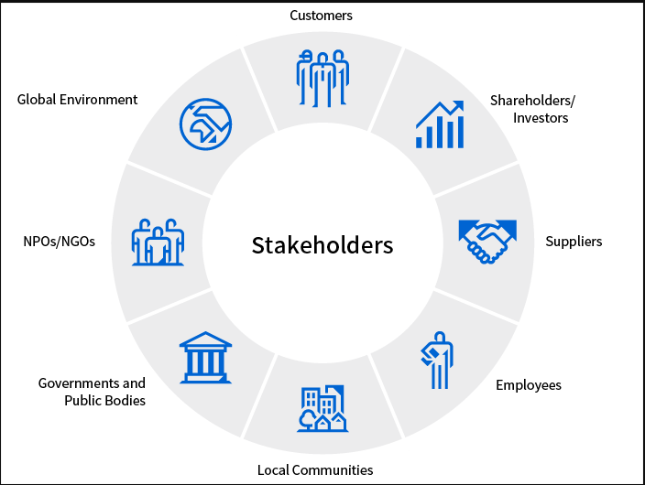
Who are the Users?
Stakeholders (users) are the individuals or groups that can influence or be influenced by (directly or indirectly) the success or failure of a project.

Slide 18
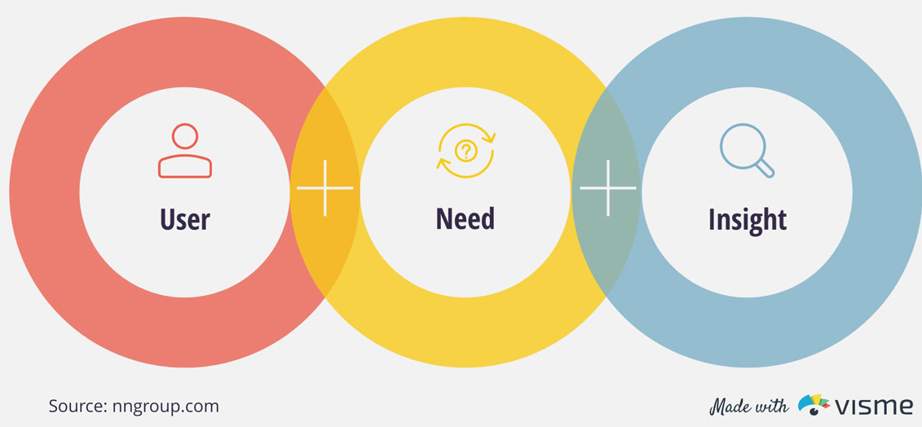
What are the User’s Needs?
Explore the problem space
Investigate users and their activities
What can be improved
Try out potential ideas
Feedback

Slide 19
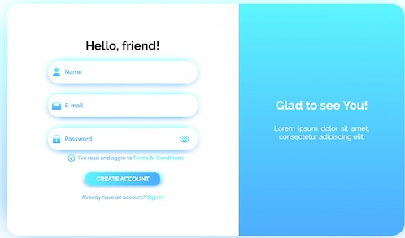
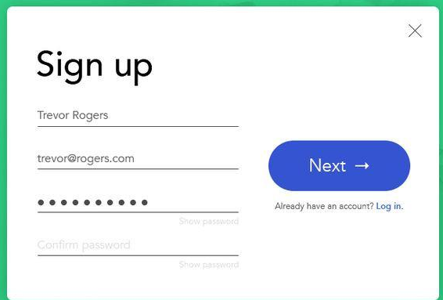
Generate Design Alternatives
Comes from seeking different perspectives and looking at other designs.
This is the process of inspiration and creativity.
Comes from seeking different perspectives and looking at other designs.
This is the process of inspiration and creativity.

Slide 20
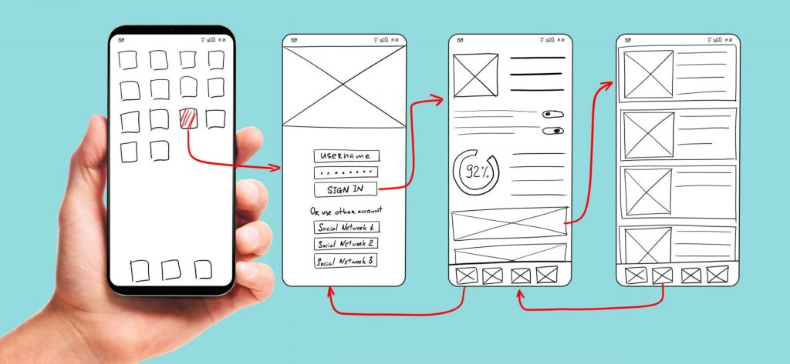
Prototyping
A prototype is a draft version of a product that allows you to explore your ideas and show the intention behind a feature or the overall design concept

Slide 21
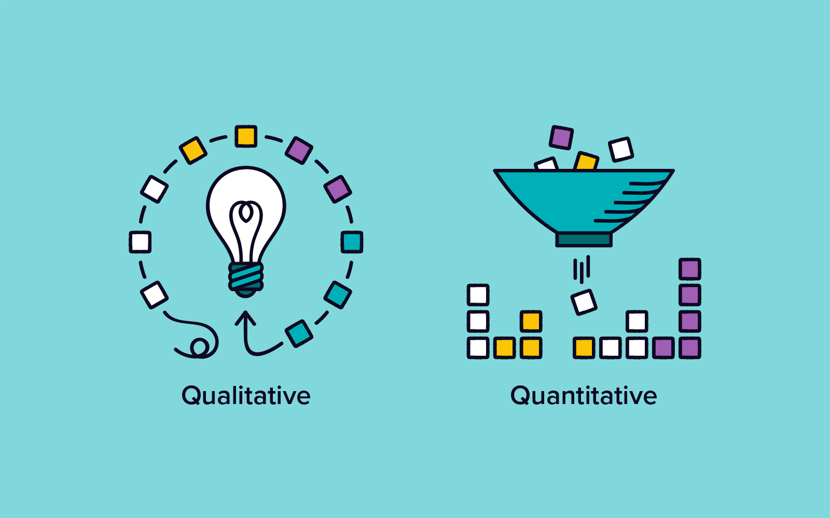
Evaluation
Evaluation is the process of measuring the usability and functionality of a system.

Slide 22
Conclusion
Interaction Design
Problem Space
User Involvement
User Centered Design
Design Life Cycle

Slide 23
Reading assignment
From book Interaction Design beyond human computer interaction (sharp)
Section 2.2.1-2.2.5
Activity 2.1

